Slide 1
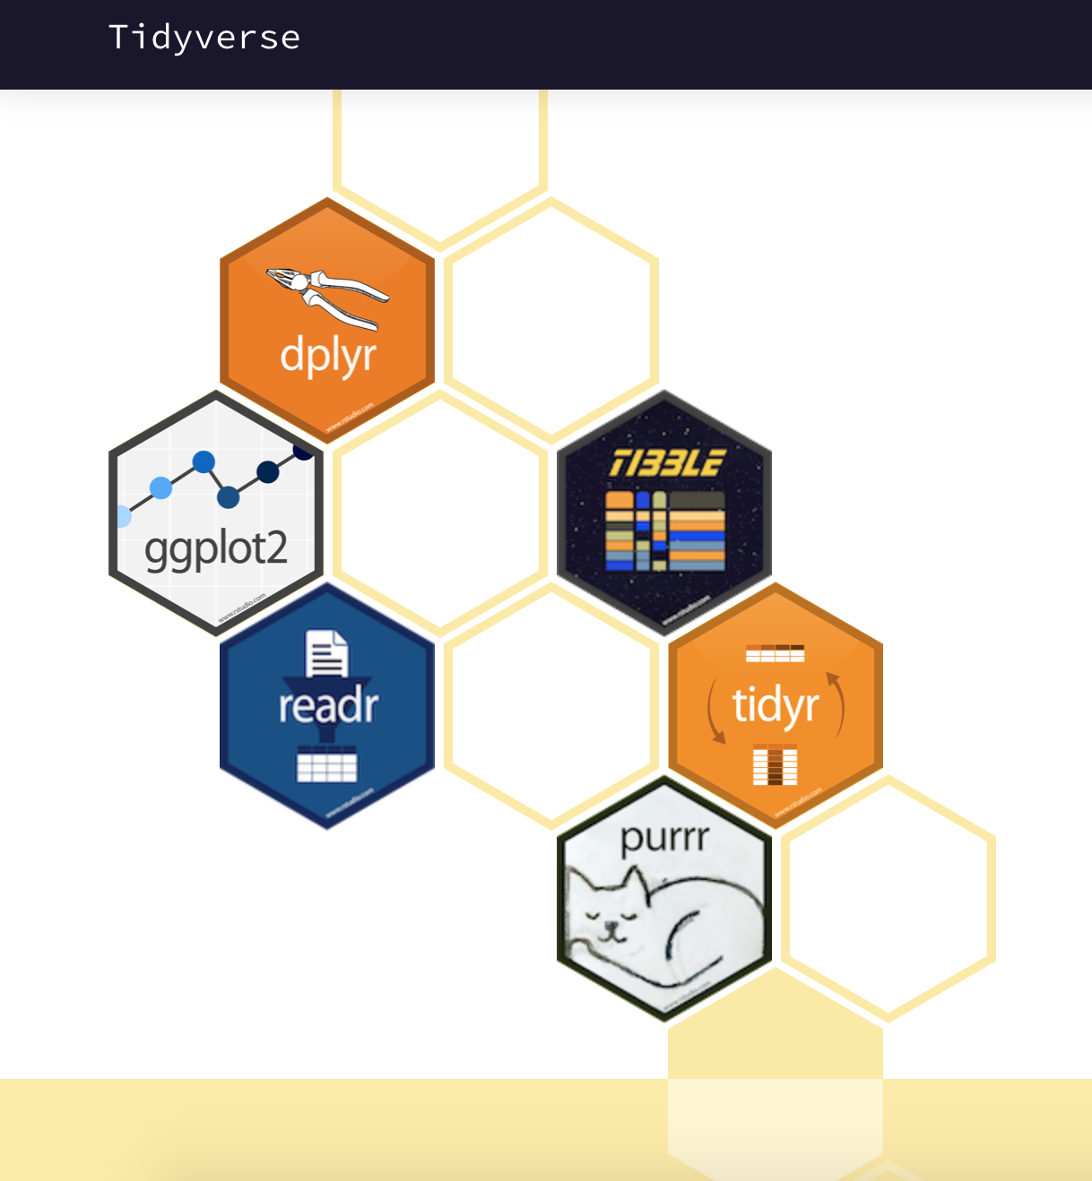

Epidemiology & Data Science
+ Script
Yanru Xing
UNIVERSITY OF FLORIDA
R for Data Science
Hadley Wickham & Garrett Grolemund

Slide 2
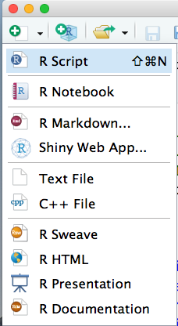
Workflow: scripts
Benefits of using scripts editor:
Automatically save and automatically load
Running code line by line, or run multiple lines by selecting
Save script as file
keyboard shortcut: Cmd/Ctrl + Shift + N
File menu > selecting New File > R script

Slide 3
RStudio diagnostics
The script editor will highlight syntax errors with a red squiggly line and a cross in the sidebar:
What other common mistakes will RStudio diagnostics report? Readhttps://support.rstudio.com/hc/en-us/articles/205753617-Code-Diagnostics to find out.
Hover over the cross to see what the problem is:
RStudio will also let you know about potential problems:

Slide 4
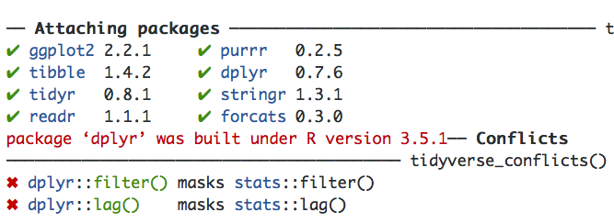
install.packages("tidyverse")

Slide 5
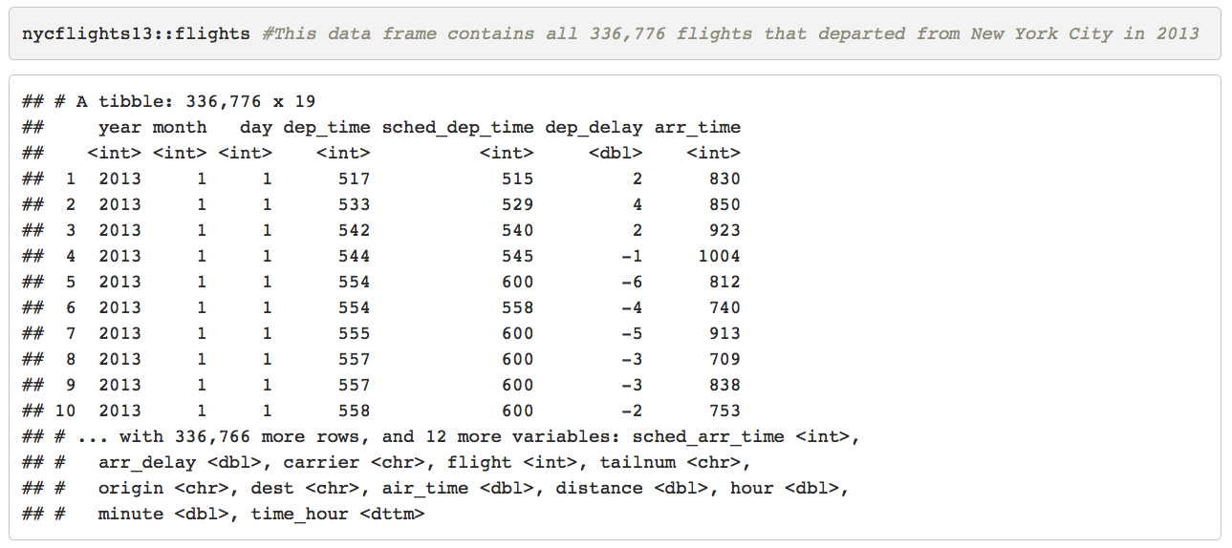
dplyr --- A Grammar of Data Manipulation
library(nycflights13)
library(tidyverse)
Type of each variable:
int --- intergers
dbl --- doubles or real numbers
chr --- character vectors, or strings
dttm --- date-times (a data + a time)
lgl --- logical, vectors contain only TRUE or FALSE
fctr --- factors, categorical variables
data --- dates

Slide 6
Five key dplyr functions
filter( ) --- pick observations by their values
arrange( ) --- reorder the rows
select( ) --- pick variables by their names
mutate( ) --- create new variables with functions of existing variables
summarise( ) --- collapse many values down to a single summary
The first argument is a data frame
The subsequent arguments describe what to do with the data frame
The result is new data frame

Slide 7
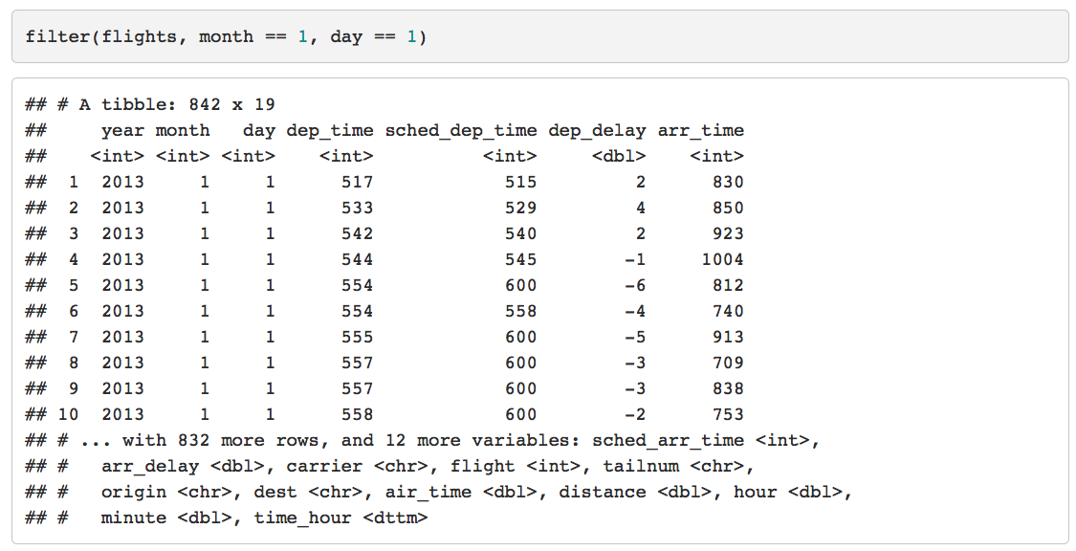
Filter rows with filter( )
filter() allows you to subset observations based on their values. The first argument is the name of the data frame. The second and subsequent arguments are the expressions that filter the data frame. For example, we can select all flights on January 1st with:

Slide 8
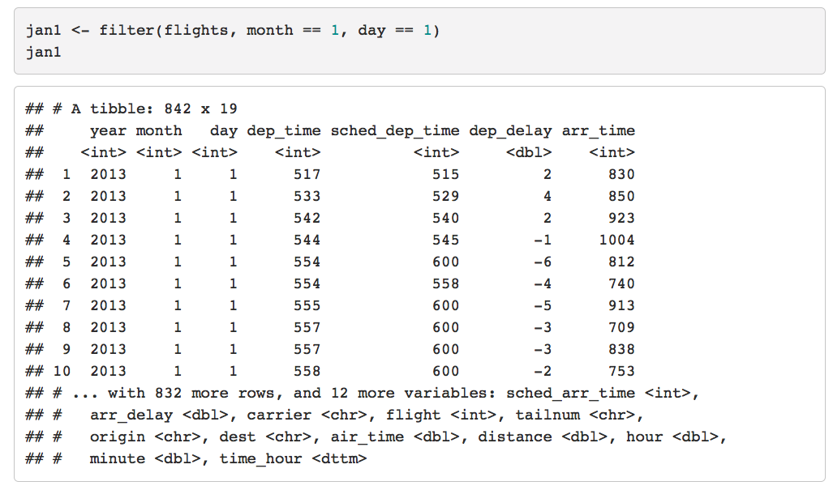

Slide 9
Comparison Operators
Select observations using the comparison operators
Standard suite: >, >=, <, <=, != (not equal), and == (equal)
The easiest mistake to make:
filter(flights , month = 1) #> Error: filter() takes unnamed arguments. Do you need `==`?
Another common problem you might encounter when using ==: floating point numbers:
sqrt(2) ^ 2 == 2
#> [1] FALSE
1 / 49 * 49 == 1
#> [1] FALSE
near(sqrt(2) ^ 2, 2)
#> [1] TRUE
near(1 / 49 * 49, 1)
#> [1] TRUE

Slide 10
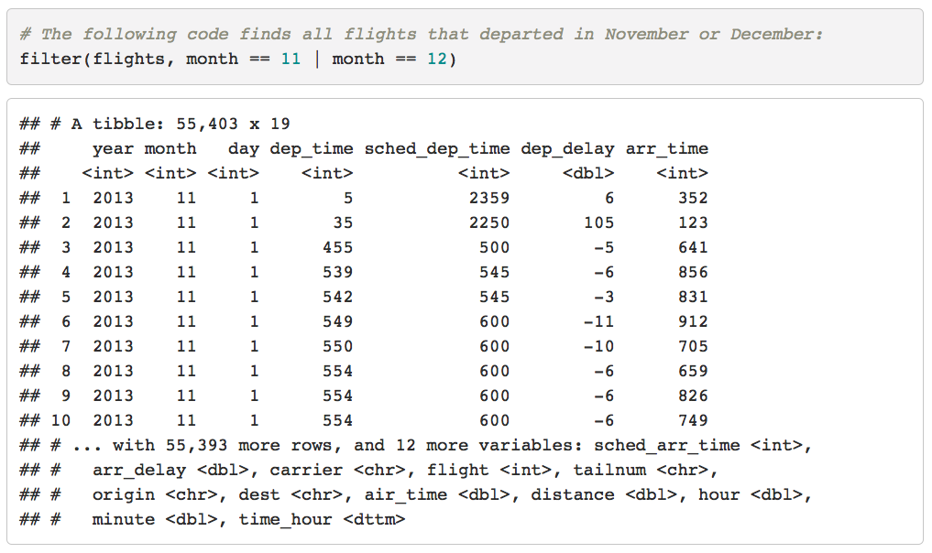
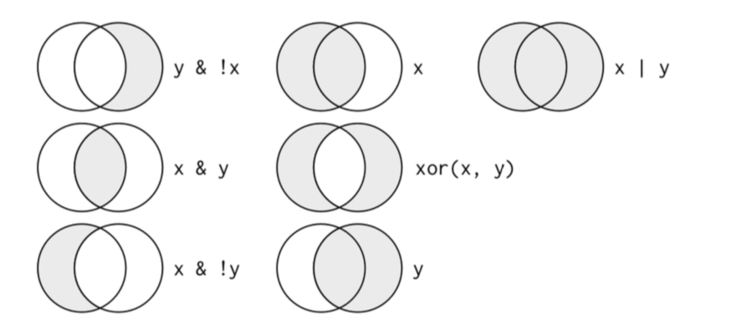
Logical Operators
Boolean operators:
& is “and”
| is “or”
! is “not”
Complete set of boolean operations. x is the left-hand circle, y is the right-hand circle, and the shaded region show which parts each operator selects.
filter(flights, month %in% c(11, 12))

Slide 11
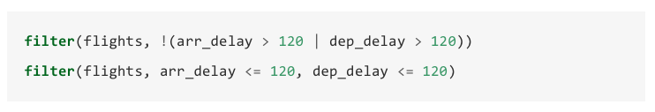
Logical Operators
!(x | y) is the same as !x & !y
Find flights that weren’t delayed (on arrival or departure) by more than two hours, you could use either of the following two filters:

Slide 12
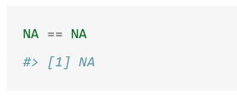
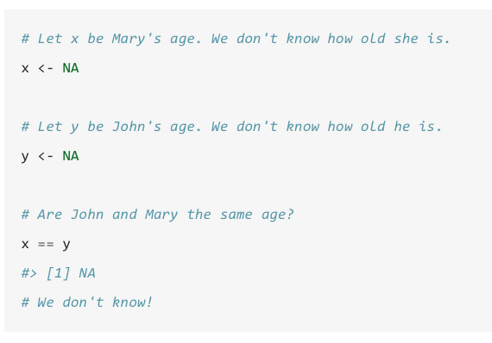
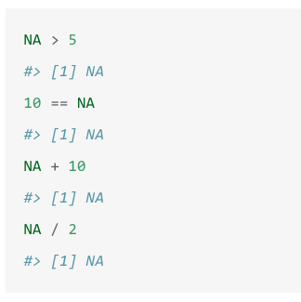
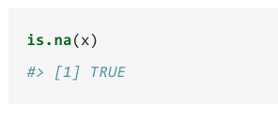
Missing Values
Missing values, or NAs (“not availables”)
NA represents an unknown value so missing values are “contagious”; almost any operation involving an unknown value will also be unknown:

Slide 13
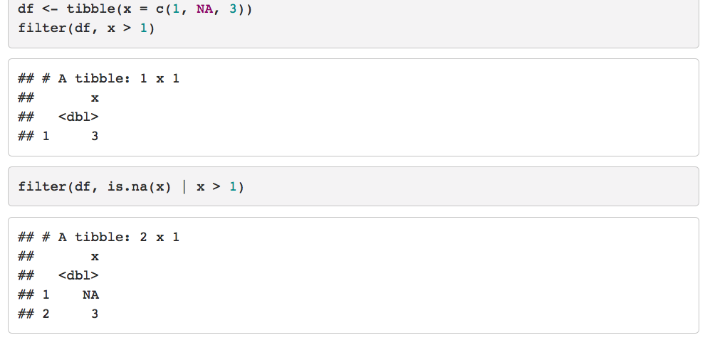
filter()
Filter( ) only includes rows where the condition is TRUE; it excludes both FALSE and NA values. If you want to preserve missing values, ask for them explicitly:

Slide 14
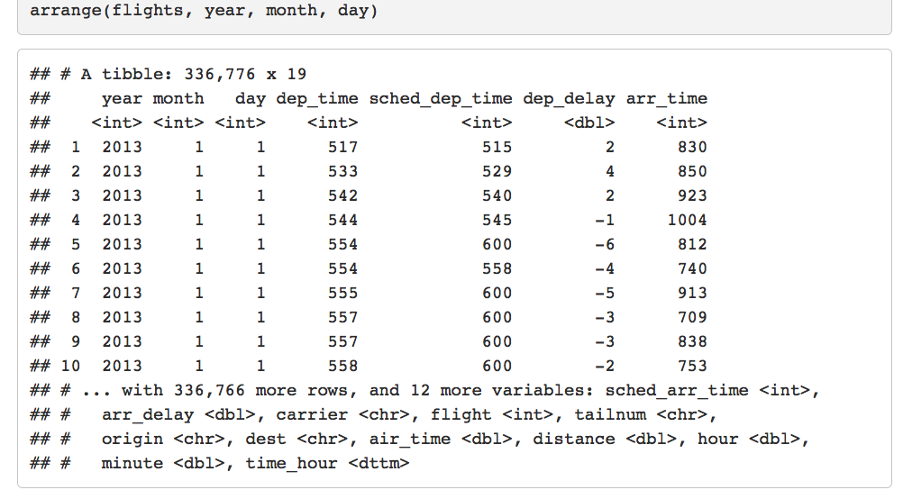
Arrange Rows with arrange()
arrange() works similarly to filter() except that instead of selecting rows, it changes their order. It takes a data frame and a set of column names (or more complicated expressions) to order by.
If you provide more than one column name, each additional column will be used to break ties in the values of preceding columns:

Slide 15
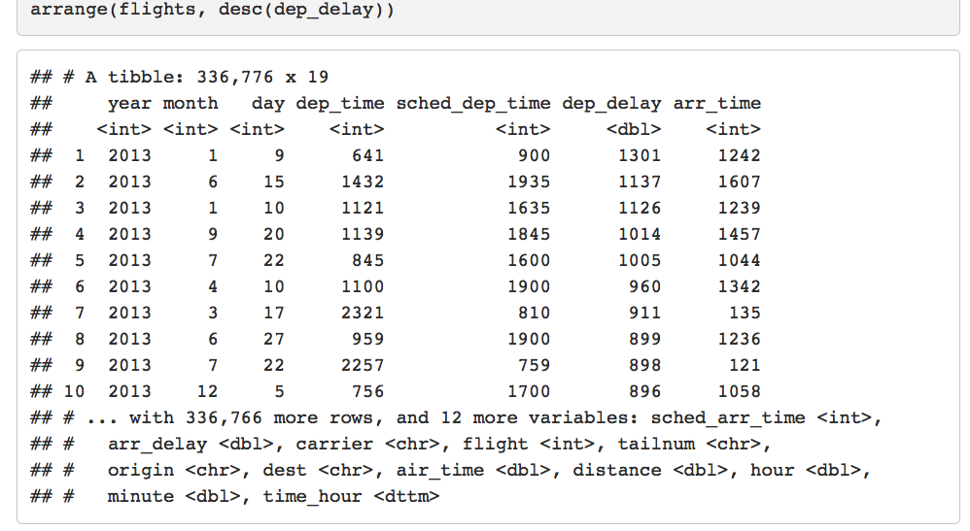
Use desc() to re-order by a column in descending order:

Slide 16
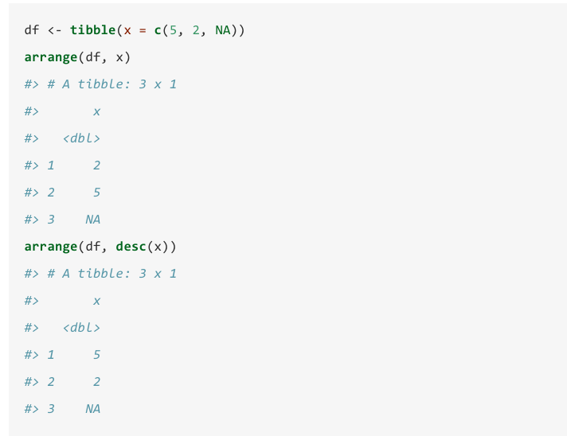
Missing values are always sorted at the end:

Slide 17
Select Columns with select()
It’s not uncommon to get datasets with hundreds or even thousands of variables. In this case, the first challenge is often narrowing in on the variables you’re actually interested in.
select() allows you to rapidly zoom in on a useful subset using operations based on the names of the variables.
select() is not terribly useful with the flight data because we only have 19 variables, but you can still get the general idea:

Slide 18
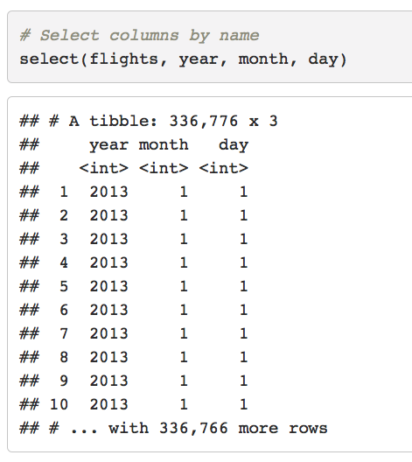
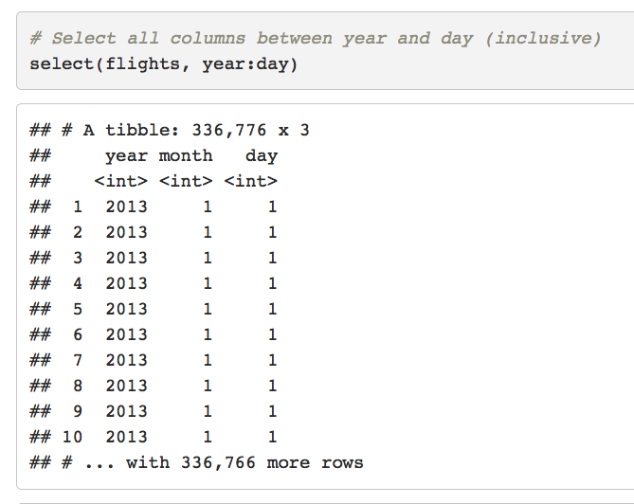

Slide 19
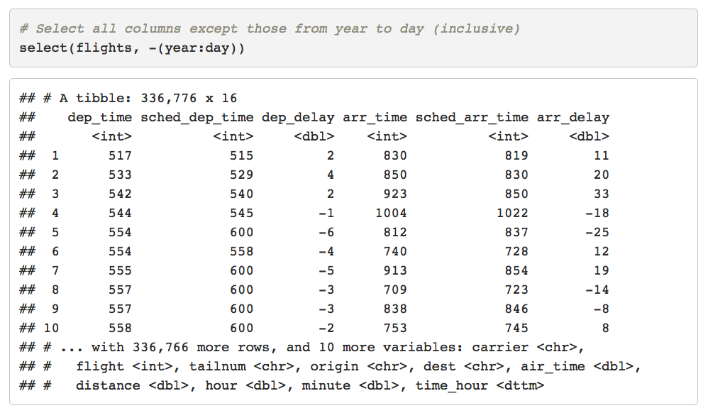

Slide 20
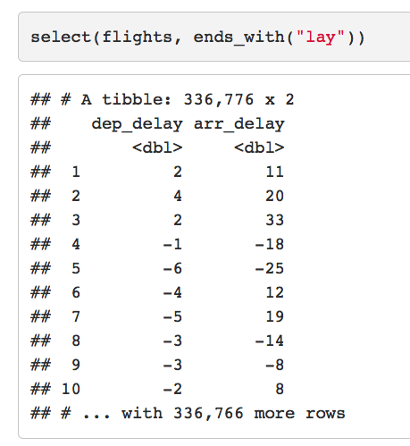
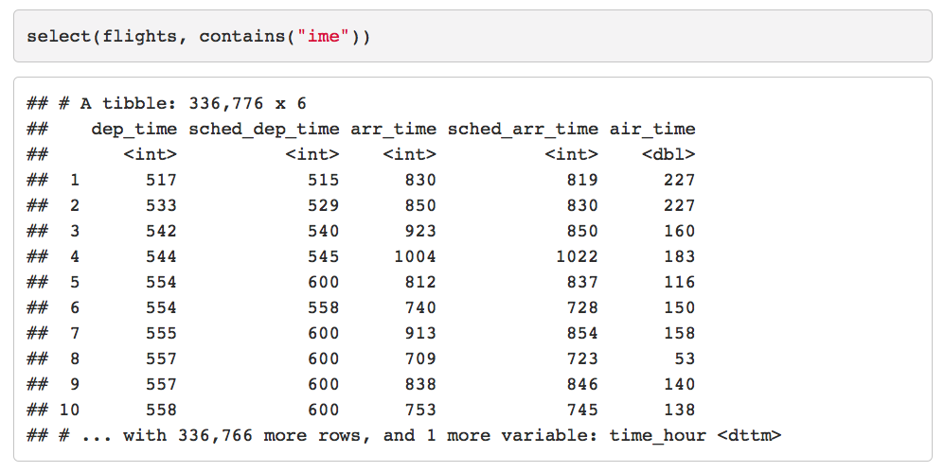
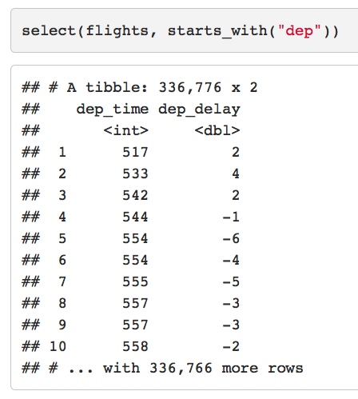

Slide 21
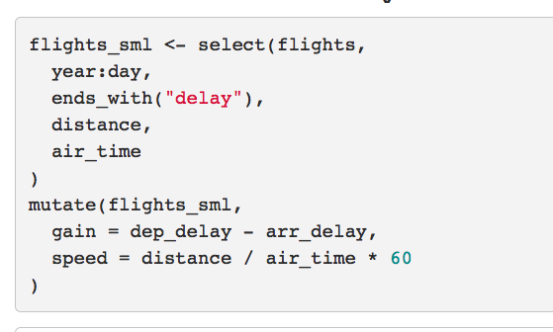
Add new variables with mutate()
mutate() adds new columns at the end of your dataset,
new columns that are functions of existing columns

Slide 22
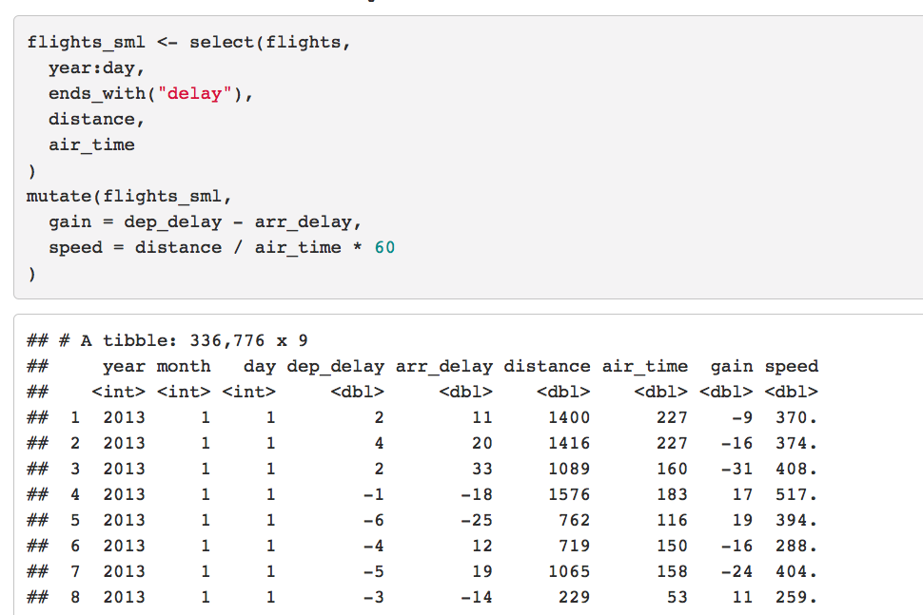

Slide 23
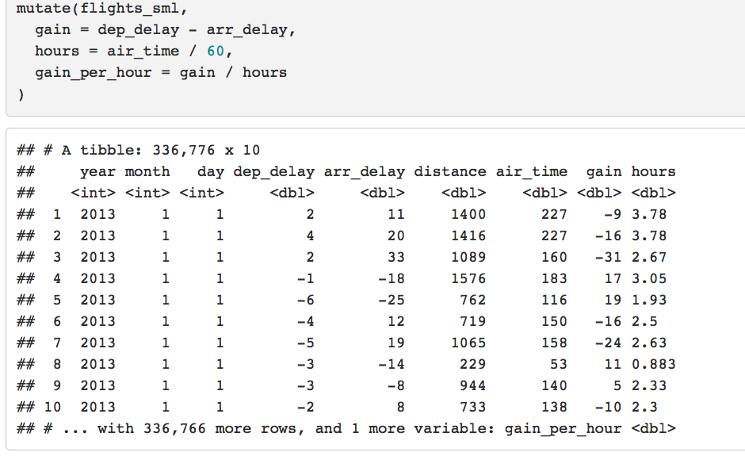
Refer to columns that you’ve just created mutate()

Slide 24
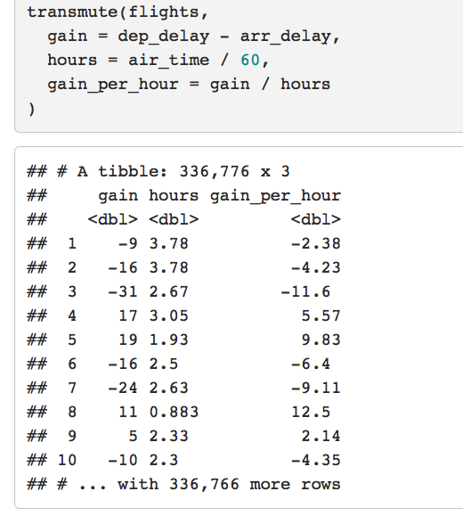
Keep the new variables transmute()

Slide 25
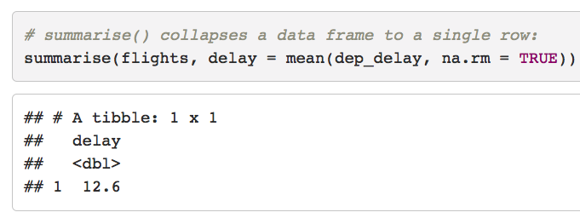
Grouped summaries with summarise()
summarise( ) collapses a data frame to a single row

Slide 26
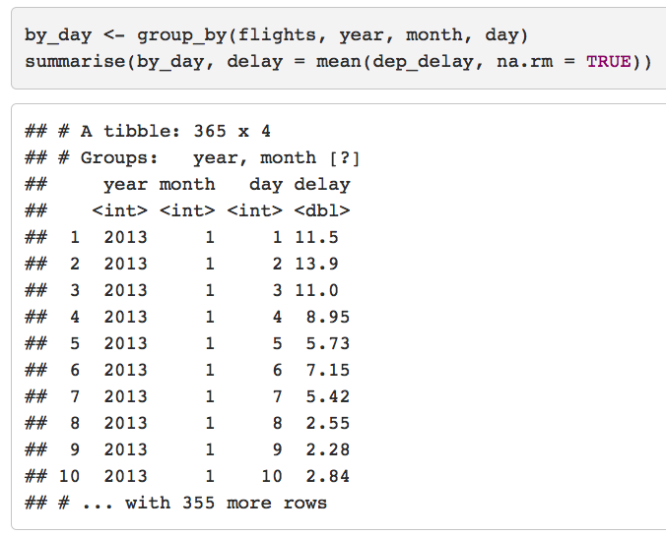
group_by(), changes the unit of analysis from the complete dataset to individual groups

Slide 27
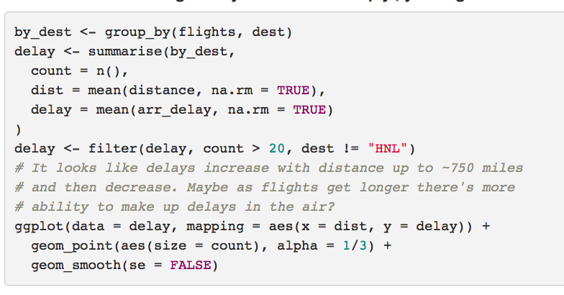
Combining multiple operations with the pipe
explore the relationship between the distance and average delay for each location

Slide 28
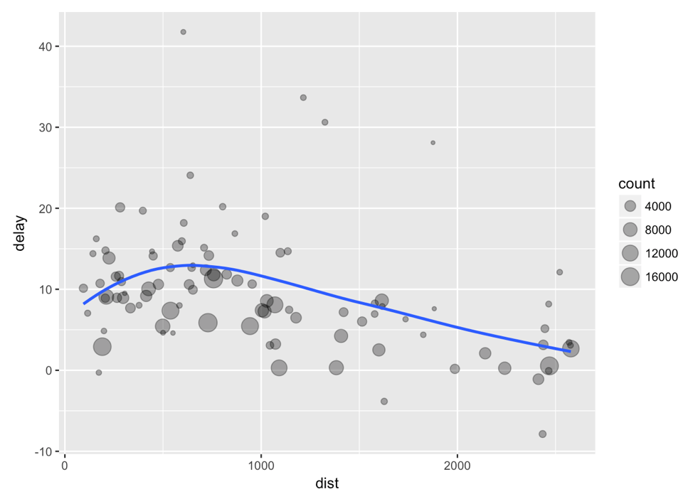

Slide 29
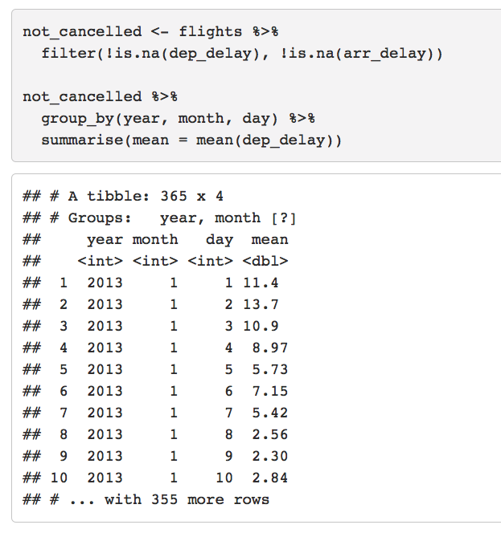
Combining multiple operations with the pipe

Slide 30
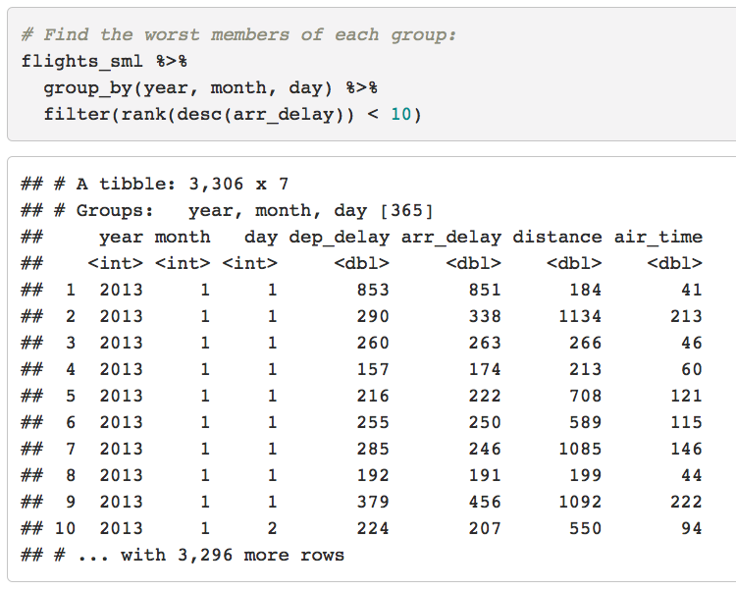
Grouped mutates (and filters)
Grouping is most useful in conjunction with summarise(), but you can also do convenient operations with mutate() and filter():

Slide 31
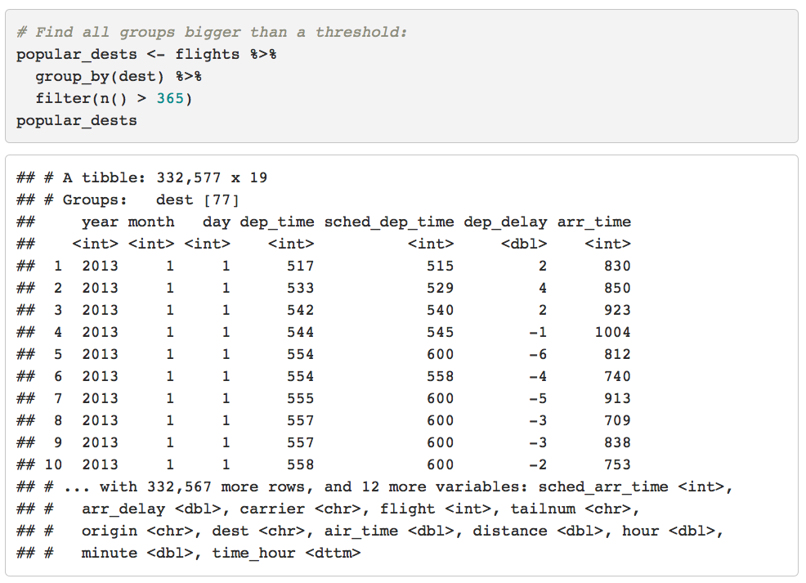

Slide 32
